Slide 1
How we embedded testing process into existing project
(*without dedicated test environment)
OLX Polska

Slide 2
Karina Petrosian
About me:
QA engineer at OLX Polska
6+ years in quality assurance

Slide 3

Imagine...

Slide 4
What pushed us?
The Will to change! :)

Slide 5


Slide 6
What to start with?
Problem elimination
Approval receiving
Solution finding
Embedding the solution

Slide 7

Problem 1:
Late testing on prod by outsource QA team

Slide 8
Testing on locally on branch before release by onboard tester
Solution:

Slide 9
What testing on branches gives us?
Early bug finding
Quick response from developers
No need in new code deploy to environment after each commit
Control of quality

Slide 10
How the testing routine looks like?
QA ...
Picks link to branch from JIRA

Slide 11
How the testing routine looks like?
QA ...
Picks link to branch from JIRA
Checks the branch out

Slide 12
How the testing routine looks like?
QA ...
Picks link to branch from JIRA
Checks the branch out
Rebuilds the environment in 3 commands:
atlas gulp; atlas init-site olxXX; atlas clear-cache

Slide 13
Problem 2:
No testing process embedded into SW development lifecycle

Slide 14

Problem 2:

Slide 15
All tasks in sprint are estimated
QA takes part into tasks estimation
Sprint capacity is calculated based on previous sprints
More meetings: Grooming, Planning, Retro
Solution:

Slide 16
Problem 3:
Road map is downgraded in favour of bugs

Slide 17
Change the work priority from fixing bugs to work on Roadmap
Keep strong focus on Sprint goals
Set up a quote of bugs to be fixed during sprint
Solution:

Slide 18
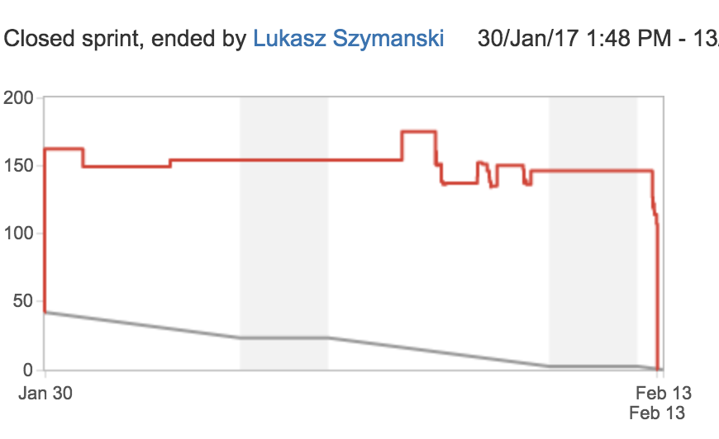
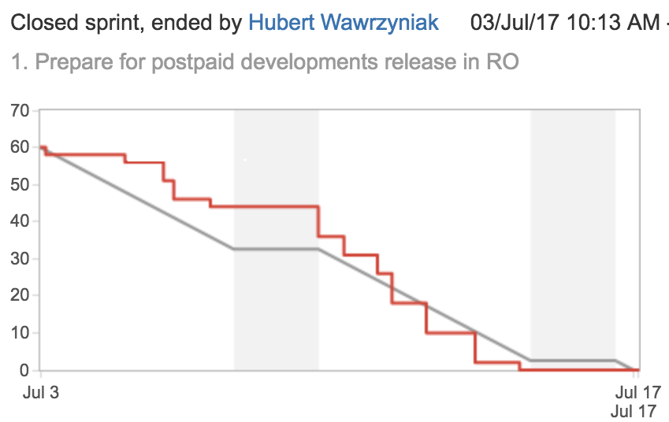
Our burndown charts:
<--was
became -->

Slide 19
Problem 4:
Not always correct perception of SCRUM

Slide 20

Popcorn on meetings :)
Communication
Retro
Solution:

Slide 21

Did we succeed in problems solving?
Late testing
No testing process embedded into SW development lifecycle
No clear understanding why we use SCRUM and what it gives us
Road map is downgraded in favour of bugs

Slide 22
The difficulties in testing did we face:
Many repos --> too complicated to switch
Building environment takes 10 to 15 minutes
All the scripts should be run manually
Long time ‘in test’--> conflicts solving before merge
One QA for 6 devs is still not enough :(
Keep the pace of bug fixing during sprint

Slide 23

The difficulties in testing did we face:
Many repos --> too complicated to switch
Building environment takes 10 to 15 minutes
All the scripts should be run manually
Late testing--> Conflicts solving before merge
Keep the pace of bug fixing during sprint
One QA for 6 devs was still not enough :(

Slide 24
The biggest problem we need to solve right now?

Slide 25

The biggest problem we need to solve right now?
#firstworldproblems

Slide 26
Questions?

Slide 27
Thank you :)

